Slide 1
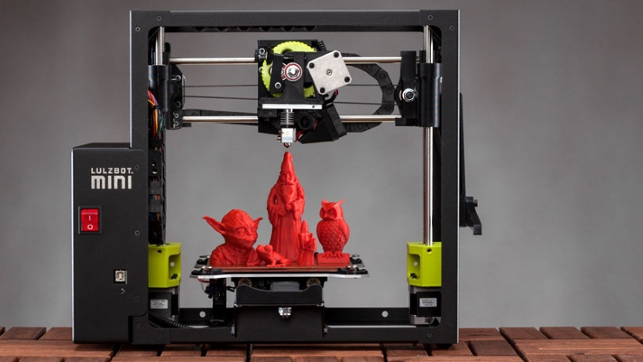
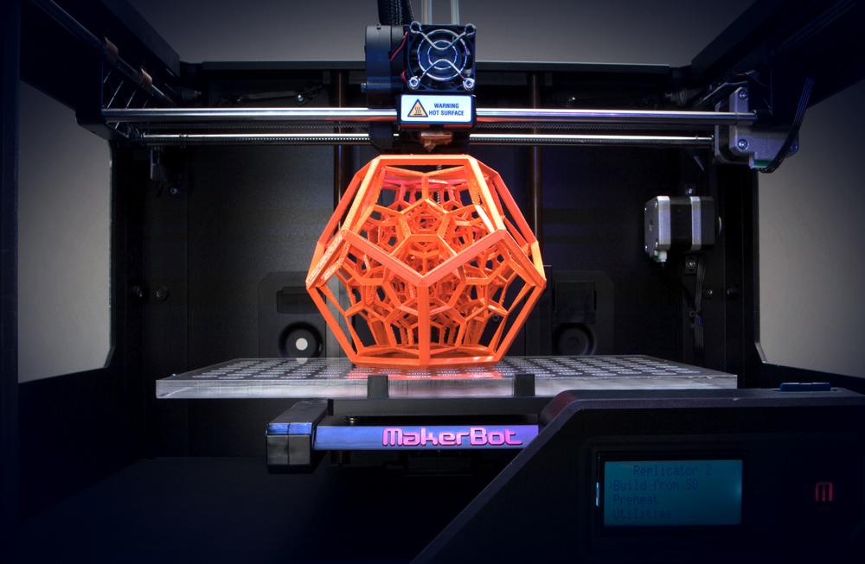
3D Printer
By: Brooke Tiede

Slide 2
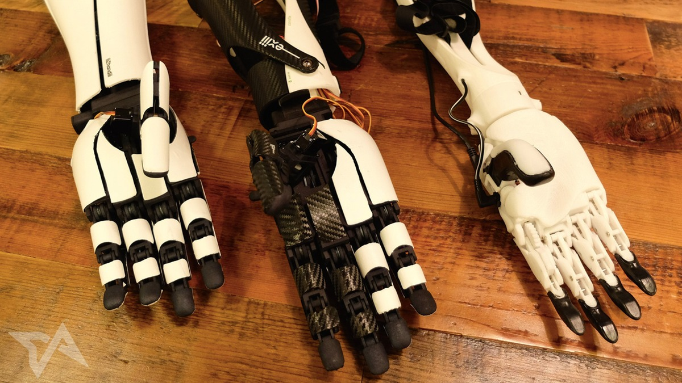
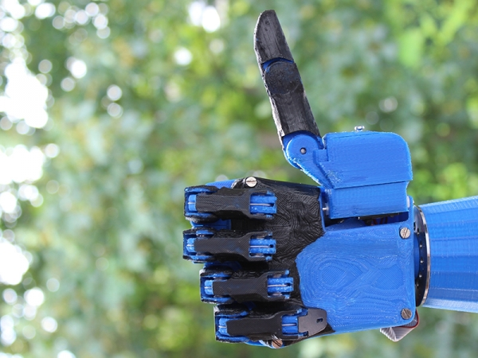
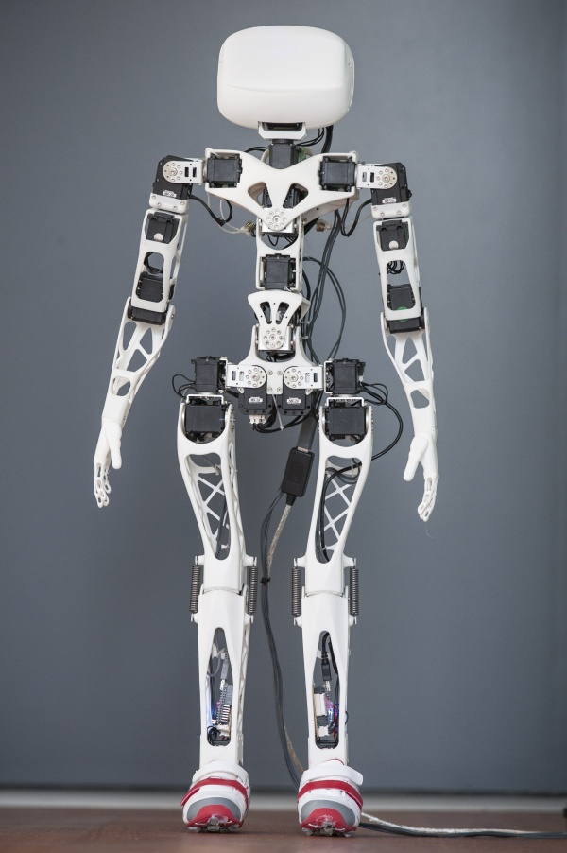
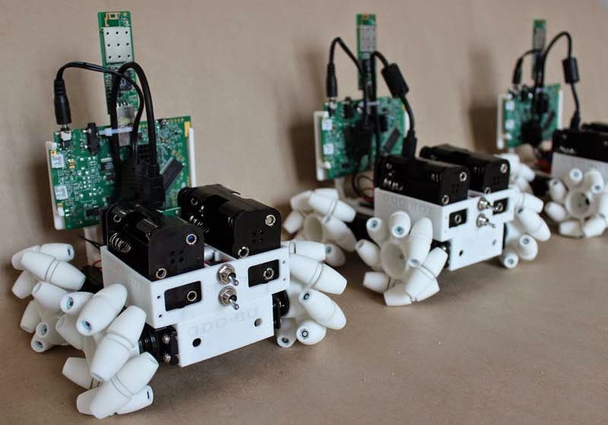
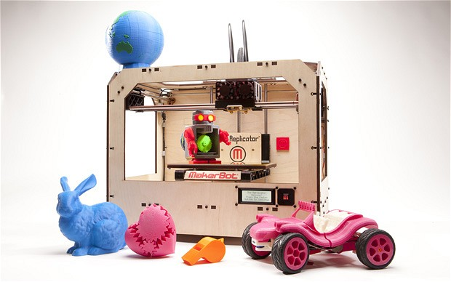
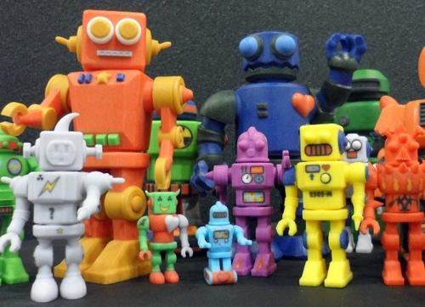
3D printer
A 3D printer is a printer that can create 3D objects. You make an 3D image on the computer than actually print them out. Its my favorite because its is useful by making robotic parts or different parts for experiments. This is also helpful because it can make limbs for amputees that need a hand or leg.

Slide 3
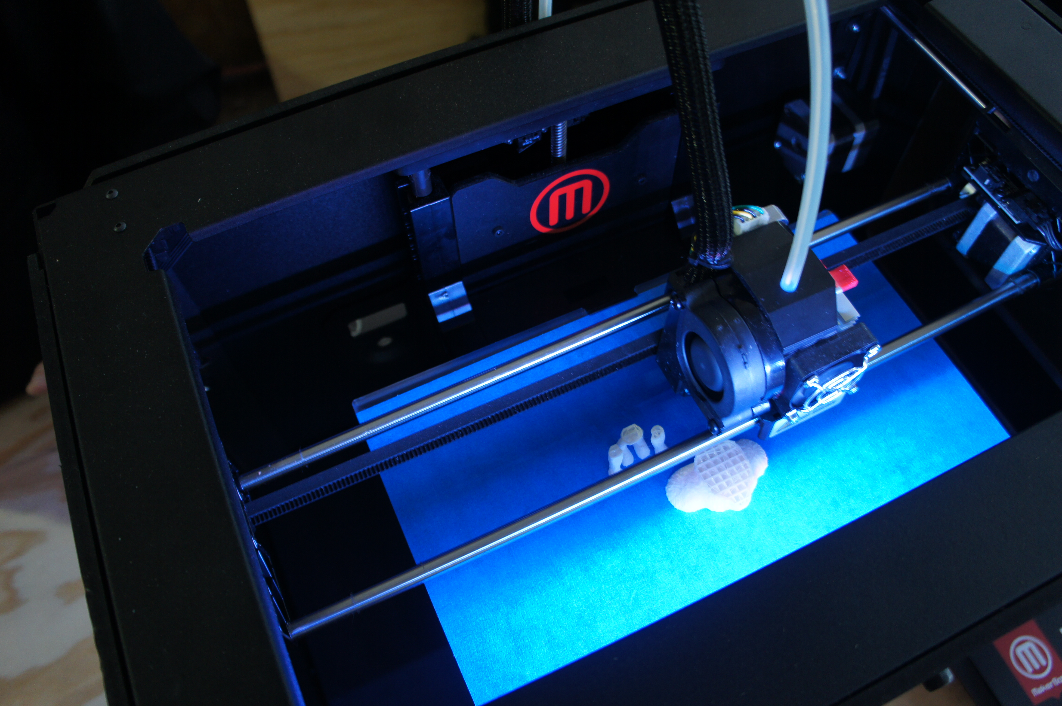
What is a 3D Printer ?
A 3D printer is a printer that you make 3D objects by creating them on the computer than printing them out.

Slide 4
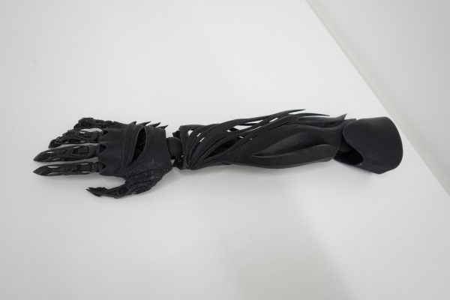
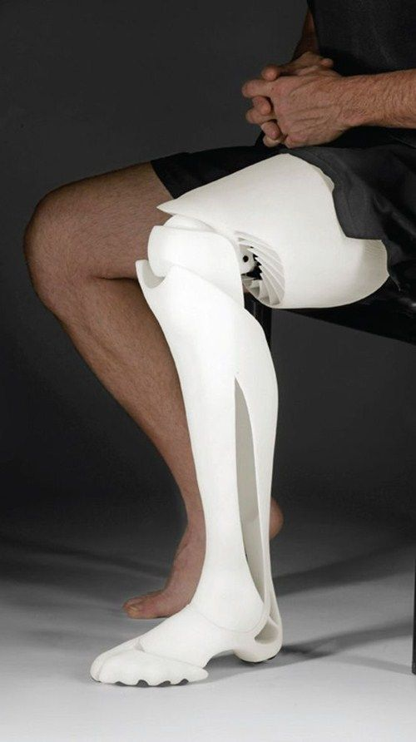
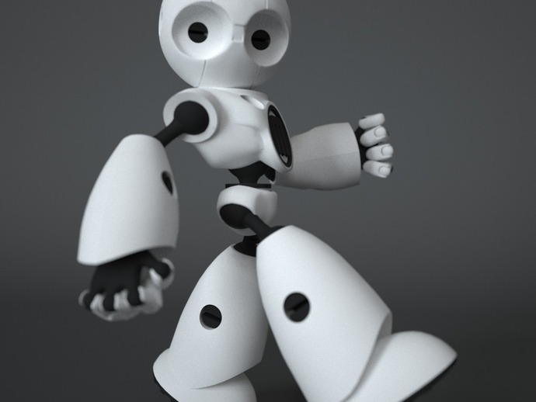
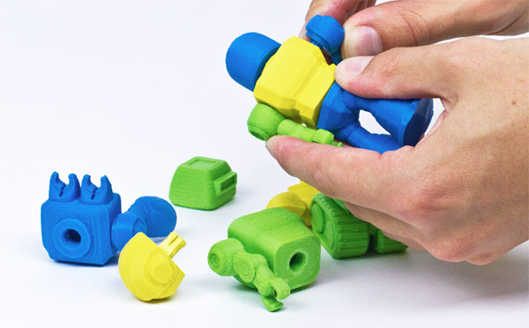
3D PRINTER
My favorite because
Can make cool toys and stuff
Make limbs for people who don’t have one
Make robot and robotic parts

Slide 5
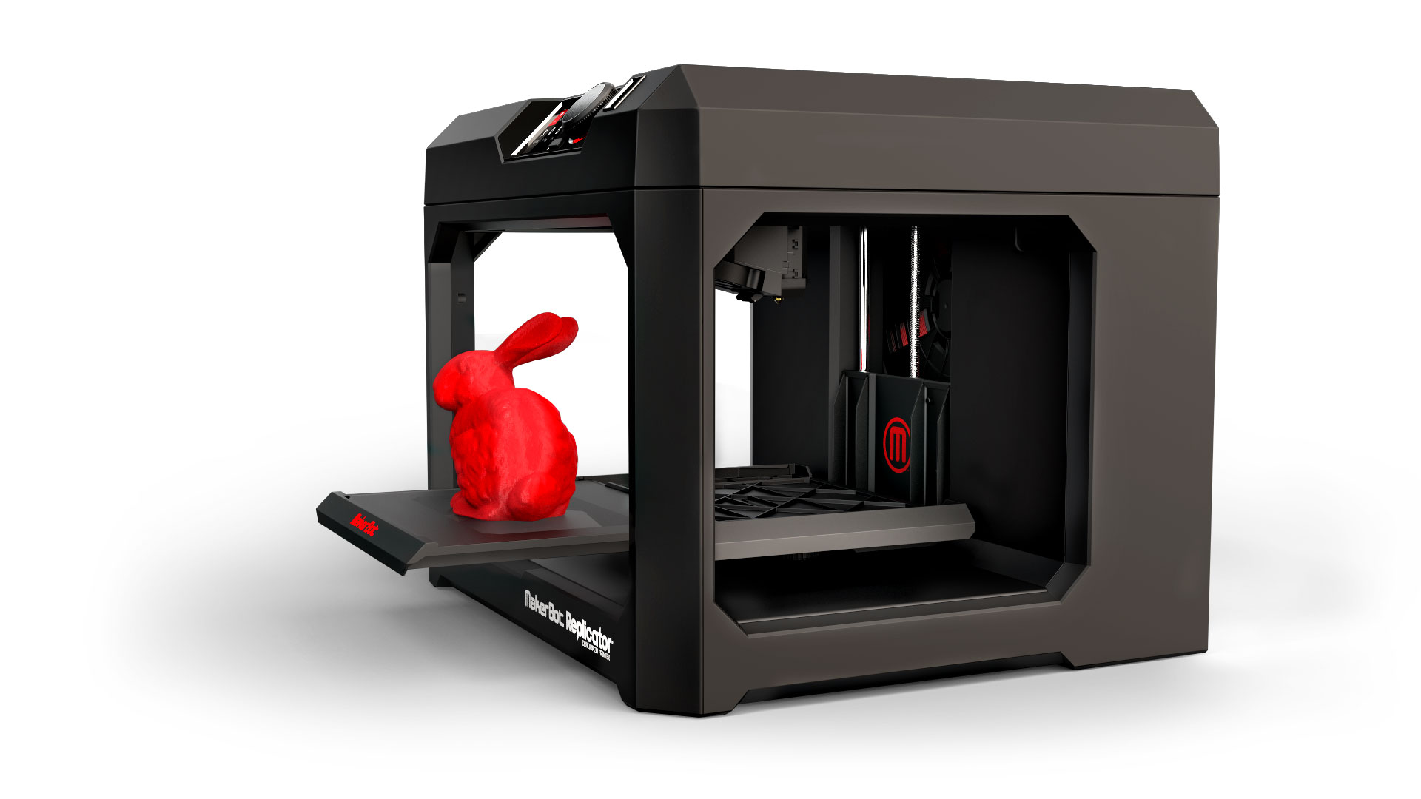
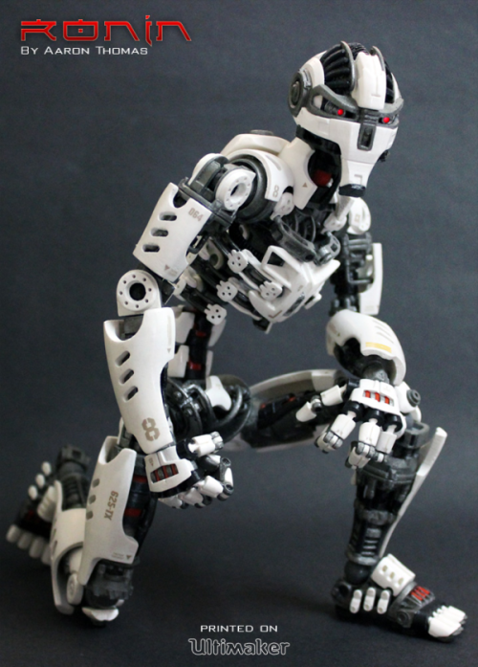
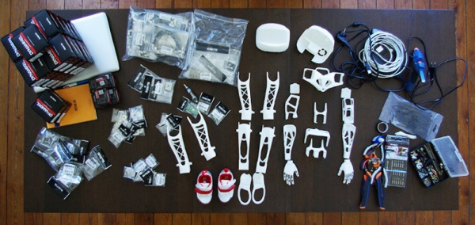
Use in schools
This can be useful for rewarding student or making robots and parts for technology classes.

