Slide 1
Lizard Point
By: Mason Case
Lizard Point.com is an excellent site for students in middle school, high school, and college to study for a variety of different subjects. Lizard Point provides an intuitive, and easy to use interface for learners of all kind.

Slide 2
Subjects, & Quick Tests
Lizard point.com allows you to take quick test on subjects in the category of Geography, Flags, World leaders, Art, Math, and Literature. You can quickly, and easily train yourself very complex, and college level topics in a matter of days.

Slide 3
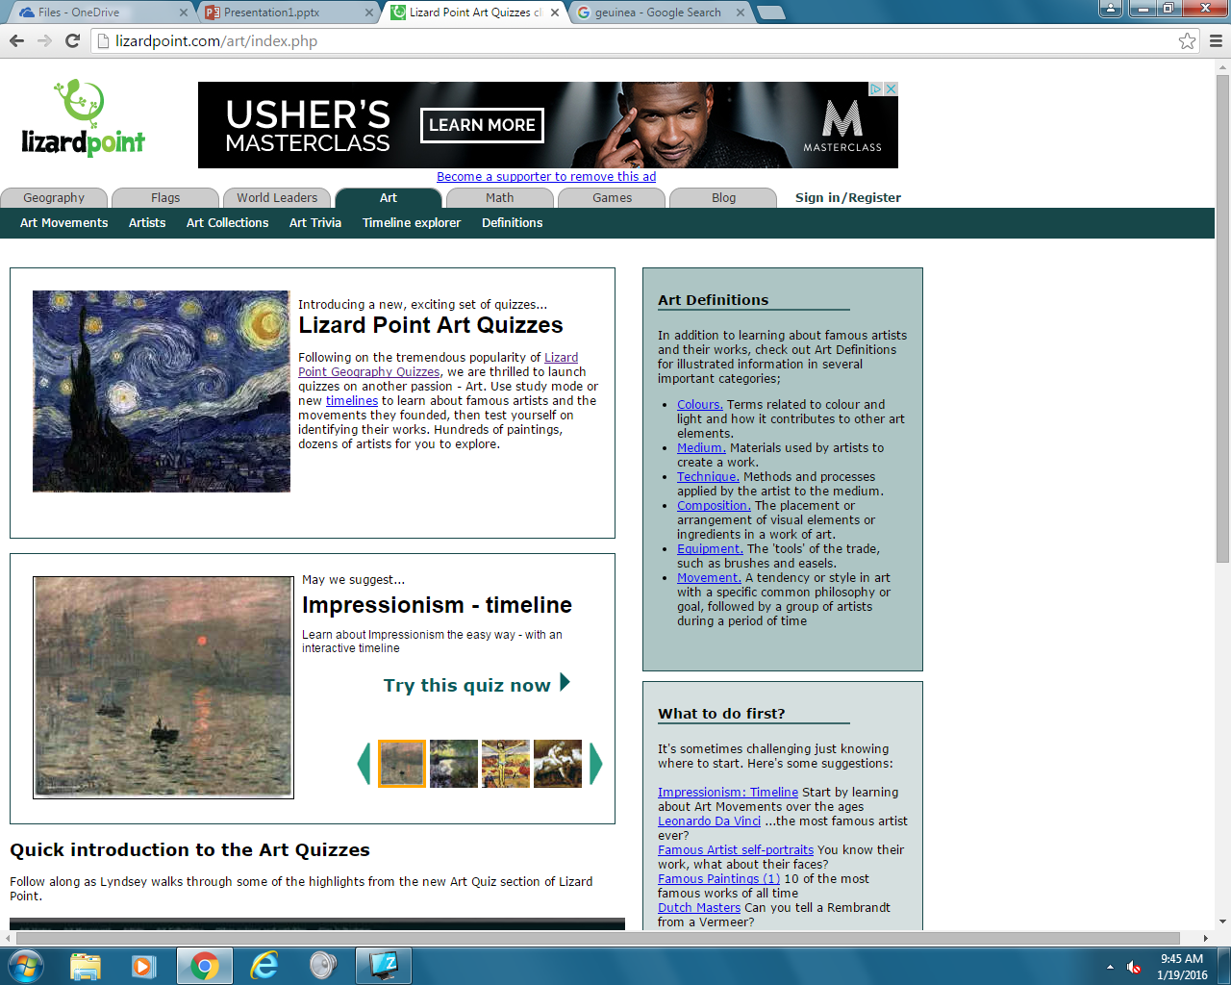
Real World Applications
This website can be used in schools, and as a very useful studying tool for teachers, and learning students. You could teach yourself topics most adults don’t know anything about.You can use your acquired knowledge to impress your teachers and peers.
Users of the site gain a better, and a more developed cognitive understanding of our world.

Slide 4
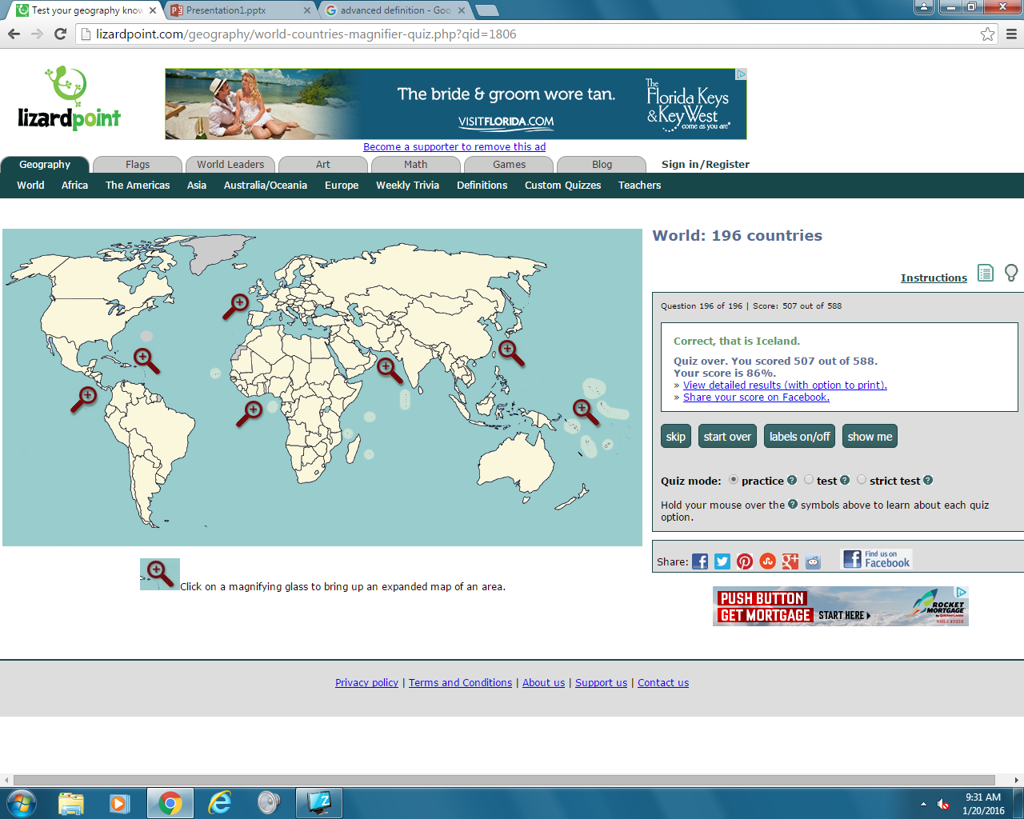
Why its my favorite
Lizard Point.com is my favorite digital learning site because it taught me way more about world history, and geography than any other class I've been in. Knowledge is by far the greatest asset a person could have. I have greatly benefitted from avidly using this site.

